Slide 1
BOOTING PROCESS

Slide 2
CONTENTS:
What is Bootloader?
Importance of Bootloader
Firmware
Booting process on x-86
Introduction to ARM335x
ARM booting process
All stages of ARM bootloader
ARM Architectures
Beaglebone Black
Raspberry pi
Friendly ARM
Device Tree

Slide 3
What is Bootloader..?
Bootloaders is also called as BOOT MANAGER.
Bootloader is a program or a set of programs, that is responsible for booting up a computer or other electronic devices.
This is typically the first program that runs when a device is turned on, and it’s main function is to load the operating system into memory and transfer control to it.
Bootloader is usually stored in a non-volatile memory(ROM).
Bootloader is responsible for performing a series of checks and initializations, including verifying the integrity of the OS and other system files, initializing hardware components.
Different devices and operating systems may have different bootloaders, each with it’s own specific features and functionalities.

Slide 4
Importances of Bootloaders
Bootloaders contains an extra layer of security that make sure that it only loads OS which has it’s approval.
Bootloaders provides a way to upgrade firmware without requiring access to the device’s internal storage.

Slide 5
Booting process?
Booting is the process of starting a computer as initiated via hardware such as a button or by a software command.
After computer is switched on, a computer CPU has no software in it’s main memory, some process must load the software into memory before it can be executed.

Slide 6
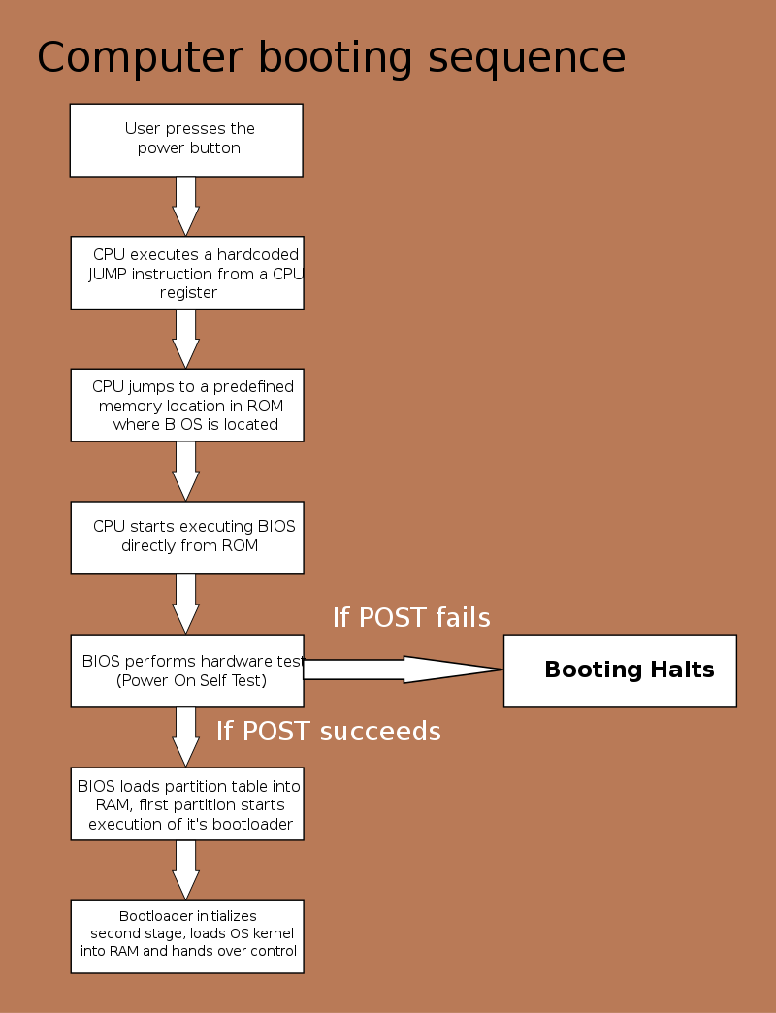
WINDOWS BOOTING PROCESS

Slide 7
What is Firmware..?
Firmware is the combination of read-only memory and program code.
Firmware is usually a minimal piece of functional code that focuses on performing the basic functions of hardware devices.
Linux kernel-core packages requires the firmware packages because lots of networks that is supported by the kernel.
Firmware can’t be modified or deleted by the end-user just like other software.
Firmware show an interface for the OS to use its services.

Slide 8
Types of Firmware
Legacy BIOS
UEFI

Slide 9
Legacy BIOS
Legacy BIOS firmware used by the BIOS to initialize hardware devices.
Legacy boot contains a selection of installed devices that get initialized as the computer performs the POST test during the boot process.
Legacy BIOS boot mode is the default mode.
Legacy BIOS only support MBR.
Legacy BIOS mode can only operate in 16-bit machines and it has less storage space of 64KB.
It can’t initialize the multiple hardware devices at a time

Slide 10
UEFI
UEFI stands for Unified Extensible Firmware Interface.
To overcome the limitations in the Legacy BIOS, we are using the UEFI more.
UEFI firmware is came into use from the 1990’s.UEFI can operate in both 32bit and 64bit machines.
UEFI has less boot time.
UEFI supports both MBR and GPT.
UEFI became more popular because, it uses a newer, more modern way of handling connections and drivers.
UEFI provides secure boot, which helps it ensure that only trusted software can run on your computer.

Slide 11
ACPI
ACPI stands for Advanced Configuration and Power Interface.
ACPI is the interface between the system hardware and the OS and its applications for configuration and power management.

Slide 12
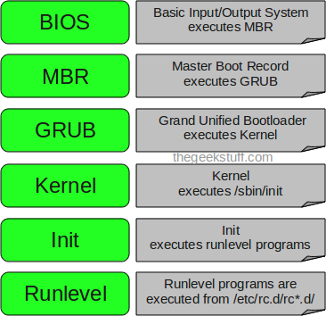
Booting process on X-86

Slide 13
BIOS
When the system is turned on, the BIOS runs self-test diagnostics to verify the system's hardware and memory. The system begins to boot automatically if no errors are found. If errors are found, error messages are displayed that describe recovery options.
BIOS does 3 steps:
RAM Detection
Hardware Detection/Initialization
Boot Sequence

Slide 14
RAM Detection
The BIOS must use some RAM in order to perform its functions. To use the RAM, the BIOS must first detect the type and quantity of RAM chips installed. This can only be done while the CPU is running code that is stored in ROM, specifically. Once the RAM has been detected, the BIOS may perform a simple memory test on it, and then the BIOS loads data and code into several memory areas in RAM.
HARDWARE DETECTION/INITIALIZATION
The BIOS detects, configures, and initializes every bus, and almost every piece of hardware on the system. It stores a great deal of information about all of this hardware, for the OS.

Slide 15
Boot sequence
At this point, the BIOS is done with its initialization. Now it tries to transfer control to the next stage of the bootloader process; so the BIOS must choose the "boot device".The "boot sequence", that tells the BIOS which devices to test, and in what order, to see if they exist and are bootable.
The BIOS may try to boot from a floppy disk, hard disk "C:", a USB flash memory device, a CD, a network, or something else. Then BIOS will transfer control to the first valid boot device that it finds, as it searches through the boot sequence.

Slide 16
MBR (MASTER BOOT RECORD)
MBR stands for Master Boot Record. Master Boot Record is the first sector of a hard disk and the place where all the information about the disk and booting can be found. It is the most essential part of the booting process. Along with the bootloader program, MBR also contains details regarding the partitions of the hard disk. The size of MBR is commonly less than or equal to 512 bytes.
MBR, is the first sector of a hard disk and determines the location of the operating system (OS) to complete the execution of the booting process. MBR is often called the partition sector or master partition table because of its components. It consists of a table that holds details of the partitions of the hard disk and their locations.

Slide 17
Contd…
BIOS contains the code that locates and executes MBR. MBR contains a partition table holding locations of various hard disk partitions which further helps in loading the operating system.
MBR contains 3 parts
Master Boot Routine
Disk Partition Table (DPT)
Identification Code
FUNCTIONS OF THE MBR
The Master Boot Record will examine the hard disk partition table to verify if it is in excellent working condition and will look for a bootable partition active in the partition table.
MBR also aids in the memory storage of the contents of the active partition's initial logical sector.

Slide 18
Contd…
1. Master Boot Routine
The MBR begins with the master boot routine that contains a variable loader code. Users can boot various operating systems from the MBR. Once the hard disk is booted, MBR passes control to the Operating System that has been registered in the partition table. The size of this component is 446 Bytes.
2. Disk Partition Table (DPT)
The disk partition table is located at the first sector of each hard disk and contains locations of the partitions. The disk partition table is usually 64 bytes long. It contains a maximum of 4 partitions that can be 16 bytes each. If the user requires more partitions, they are free to create an extended partition.
3. Identification Code
Identification code is used to identify an MBR and acts as a closing signature. Its value is AA55 H and may also be written as 55AA H. The identification code is 2 bytes long.

Slide 19
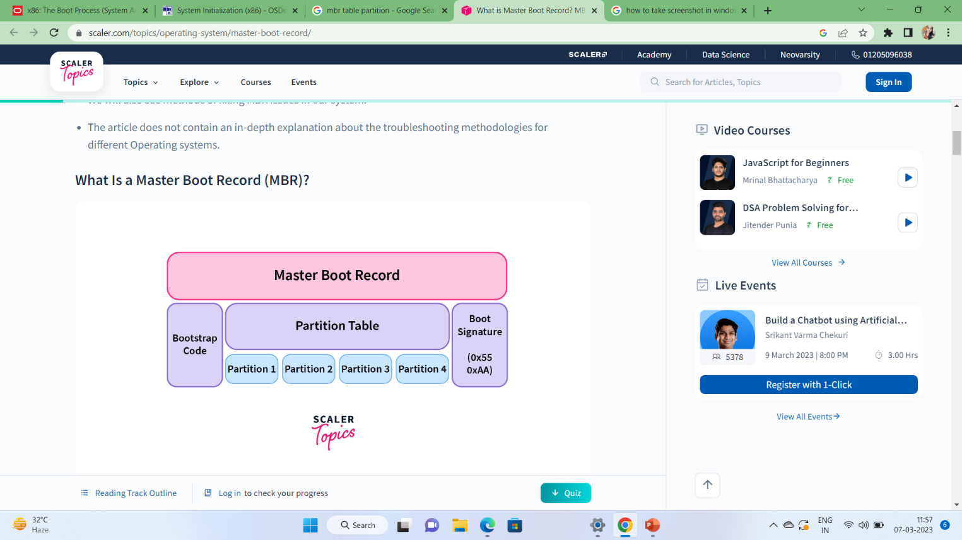
Block Diagram

Slide 20
GPT(GUID Partition table)
GUID Partition Table (GPT) is a standard table that is used to store details of partition tables. GPT is considered to be the successor of MBR as it maintains all partition-related data and the boot code of the Operating System.
Unlike in MBR, you can create multiple (up to 128) partitions in GPT. Also, a supported hard disk drive size can be as big as 9.44 million TB. This means that GPT disk can provide much more storage than MBR.
Since in a GPT data is stored all across the drive, there is a guarantee that in case a partition is deleted or damaged, data will still be retrievable. GPT also makes use of CRC (Cyclic Redundancy Check) to ensure data security. This error check mechanism provides GPT with a higher factor of reliability.

Slide 21
GRUB
The GRUB boot loader was written by Erich Boleyn to boot operating systems on PC-based hardware, and is now developed and maintained by the GNU project.
GRUB provides a graphical menu interface. It also provides a command interface that is accessible both while the system is booting and from the command line once Linux is running.
The graphical menu interface shows you exactly what your choices are for booting so you don’t have to remember them. It also lets you easily edit an entry on the fly, or drop down into the command interface. In addition, if you are using the menu interface and something goes wrong, GRUB automatically puts you into the command interface so you can attempt to recover and boot manually.

Slide 22
Contd…
A GRUB installation consists of at least two and sometimes three executables, known as stages . The stages are:
Stage 1 is the piece of GRUB that resides in the MBR of another partition or drive. Since the main portion of GRUB is too large to fit into the 512 bytes of a boot sector, Stage 1 is used to transfer control to the next stage, either Stage 1.5 or Stage 2.
Stage 1.5 is loaded by Stage 1 only if the hardware requires it. Stage 1.5 is filesystem-specific; that is, there is a different version for each filesystem that GRUB can load. The name of the filesystem is part of the filename. Stage 1.5 loads Stage 2.
Stage 2 runs the main body of the GRUB code. It displays the menu, lets you select the operating system to be run, and starts the system you’ve chosen.
To install GRUB is with the grub-install shell script.

Slide 23
DIFFERENCES B/W GRUB & LILO
Features | GRUB | LILO
Definition | A boot loader offered by the GNU project is called GRUB. | It is a Linux bootloader that replaced loadlin as the default boot loader for most Linux OS in the years following its success.
Introduction | It was introduced in 1995 | Werner Almesberger was the first to introduce the LILO from 1992 to 1997.
Supporting OS | It supports multiple OS, including Windows, macOS, Linux, Unix, BSD, and Solaris. | It supports only a single operating system which is Linux OS.
Complexity | It is more complex than LILO | It is simple and easy to use.
GUI Menu Choice | It includes a GUI menu choice | It doesn't include a GUI menu choice.
Development | It is developed by GNU Project | Werner Almesberger, John Coffman and Joachim Wiedorn are developers developed LILO.
Type | It is a new default boot loader | It is an old default boot loader.
Network Booting | It supports network booting. | It doesn't support network booting.
Interactive Command Interface | It supports an interactive command interface. | It doesn't support an interactive command interface

Slide 24
KERNEL & INIT
The kernel, once it is loaded, finds init in sbin and executes it.
When init starts, it becomes the parent or grandparent of all of the processes that start up automatically on your Linux system.
The first thing init does, is reading its initialization file, /etc/init. This instructs init to read an initial configuration script for the environment, which sets the path, starts swapping, checks the file systems, and so on.
INIT tells how the system should be set up in each run level and sets the default run level. A run level is a configuration of processes .
Command to check run-level who –r.
After determining the default run-level for your system, init starts all of the background processes necessary for the system to run by looking in the root directory for the run-level.

Slide 25
Setting RUN-LEVELS
ID | Name | Description
0 | Off | Turns off the device.
1 | Single-user mode | Mode for administrative tasks.
2 | Multi-user mode | Does not configure network interfaces and does not export networks services.
3 | Multi-user mode with networking | Starts the system normally.
4 | Not used/user-definable | For special purposes.
5 | Full mode | Same as runlevel 3.
6 | Reboot | Reboots the device.

Slide 26
INIT RUN-LEVELS
The idea behind operating different services at different run levels essentially revolves around the fact that different systems can be used in different ways. Some services cannot be used until the system is in a particular state, or mode, such as being ready for more than one user or having networking available.

Slide 27
ARM BOOTING PROCESS

Slide 28
ARM:
Cortex –A8 .
Architecture design is divided into 3 profiles.
A profile-designed for high performance open application platforms.
R profile-high end ES in which real time performance is needed.
M profile-deeply embedded microcontroller chips.

Slide 29
To boot ARM Linux:
Setup and initialize the RAM
Initialize one serial port
Detect the machine type
Setup the kernel tagged list
Load initramfs
Call the kernel image

Slide 30
The arm booting process is divided into 3 main stages
BOOTROM stage
Secondary program loader stage
U-boot stage(universal boot loader)

Slide 31
BOOTROM:
The BOOTROM is the very first piece of instruction to be executed when a device boots up. Or when a system undergoes hard reset (may be due to hardware reset/software reset/ power-on reset or watchdog reset), the control lands up here, in the BOOTROM.
BOOTROM (also known as internal ROM) is a non-modifiable (Read only) area of memory which is written once during manufacturing. BOOTROM can never be modified by a developer.

Slide 32
Boot ROM can supports the following boot devices:
Flash
SD/MMC
Quad SPI
Serial ROM devices (through I2C and SPI interfaces)
PCI/USB/UART etc.

Slide 33
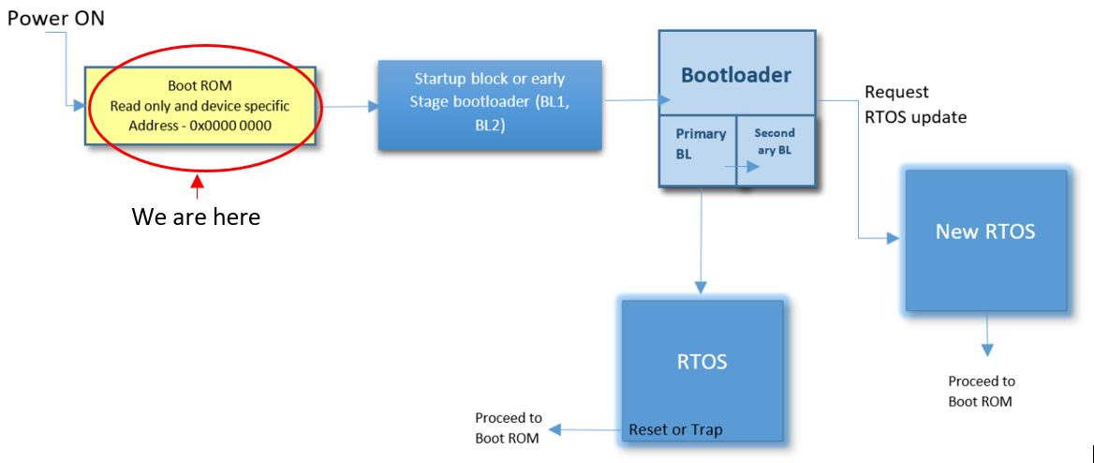
BOOT ROM

Slide 34
Internal flash memory
Size is 512KB
Begins :0x0800 0000
Ends:0x0807 FFFF
Used to store your application code and read only data of the program
It is a non volatile

Slide 35
Secondary program loader stage:
Which means that ROM code is the first thing that loads (and executes) other program, and SPL is the second thing that loads (and executes) other program. So usually boot sequence is next.
It loads the code into BOOTROM internal memory.
This is given to the U-BOOT.
SPL is required when the system internal memory can not hold the u-boot completely .so we need to initialize memory using a minimal piece of code called SPL.

Slide 36
Spl flow
BOOT ROM
PSA for FLASH
Primary core
Program counter=SP loads stack pointer reset vector table clock controlling cache timer init PSA
Program counter=SP loads stack pointer reset vector table clock controlling cache timer init PSA
Image core executes
RESET
FLASH
CORE1
CORE2
secondary core
Image core executes this
SRAM
PSA for SRAM

Slide 37
U-BOOT
U-Boot is both a first-stage and second-stage bootloader. It is loaded by the system's ROM
From a supported boot device, such as an SD card, SATA drive, NOR flash
Loads the kernel image
Load device tree binary(DTB) from FLASH TO SDRAM/DDRAM and start it.

Slide 38
U-BOOT compilation steps:
Download the u-boot source code from :https://source.denx.de/u-boot/u-boot.git
Download the corresponding tool chain for architecture related. From: For 32 bit Arm: gcc-arm-9.2-2019.12-x86_64-arm-none-linux-gnueabihf.tar.xz
For 64 bit Arm: gcc-arm-9.2-2019.12-x86_64-aarch64-none-linux-gnu.tar.xz
make ARCH=arm <board defconfigs>
make ARCH=arm CROSS_COMPILE=<toolchain prefix>

Slide 39
All stages of bootloader
Boot stage number | Terminology 1 | Terminology 2 | Actual program name
1 | Primary program loader | - | ROM code
2 | Secondary program loader(SPL) | 1st stage bootloader | U-boot SPL
3 | - | 2nd stage bootloader | U-boot
4 | - | - | kernel

Slide 40
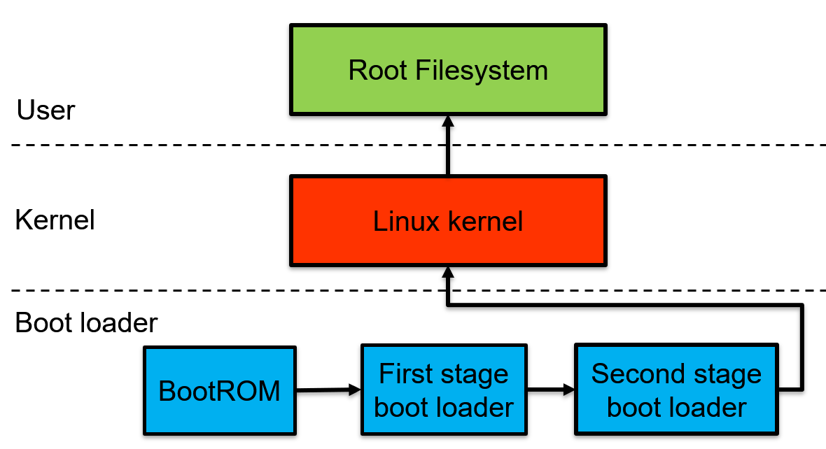
ROOT FILE SYSTEM

Slide 41
ARM architectures
Board vendors of ARM Architecture are as follows :
Raspberry pi.
Beagle bone.
Friendly arm.

Slide 42
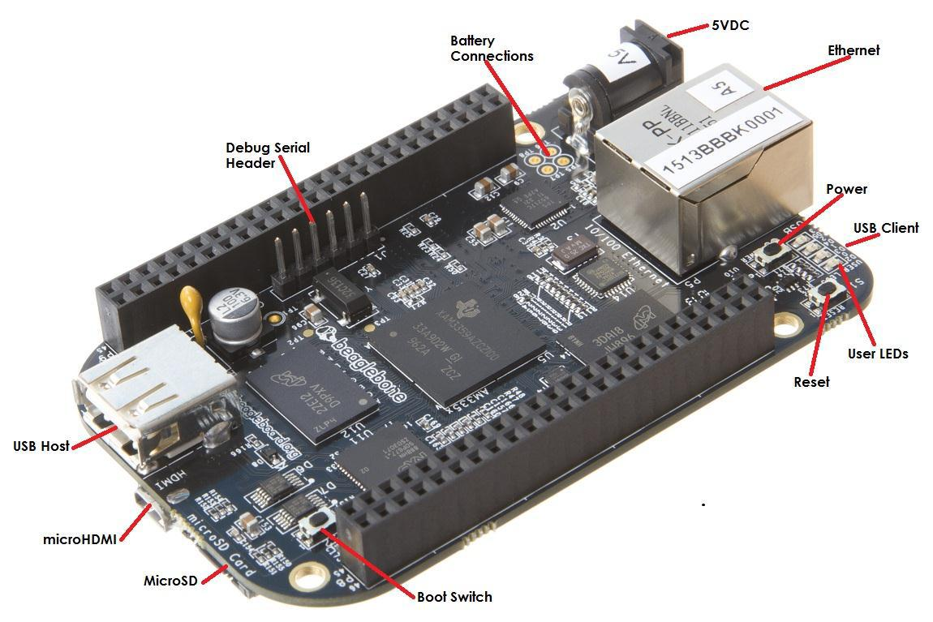
Beagle bone black booting process

Slide 43
Contd..
The beagle bone black contains 3 type of buttons :
Power button: Alerts the process to initiate the power down sequence.
Reset button: Allows the user to reset the processor.
Boot button: It can be used to force a boot from the SD card.
The BBB board contains 4 indicators for status of board in the sequences. Once the linux kernel loaded in the board after completion of booting process.
USER0(indicator 1):which is the heartbeat indicator from the linux kernel .
USER 1:turns on when the SD card is being accessed.
USER2:it turns on when the kernel is not in the idle loop(process running state).
USER3:Turns on when the onboard EMMC is being accessed.

Slide 44
Different types of memories in bbb
1. 32kB EEPROM:
A single 32kB EEPROM is provided on I2C0 that holds the board information. This information includes board name ,serial number and revision information.
2. 2GB embedded mmc(EMMC):
A single 2GB EMMC device is on the board. The device connect to the mmc1 port of the processor ,allowing for 8bit wide accessing .The default boot mode for mmc1 with an option to change it to mmc0 for SD card booting mmc0 can’t be used in 8bit mode.
3. Micro SD connector:
The board is equipped with a single micro SD connector to acts as the secondary boot source for the board and if selected as such can be primary boot source.

Slide 45
Contd…
Different booting modes for BBB :
1. EMMC boot :
This is the default boot mode and will allow for the fastest boot time and will enable the board to boot out of the box using the pre-flashed OS image.
2. SD card boot:
This mode will boot from the USD slot. In this mode can be used to override what is on the EMMC device and can be used to program the EMMC.
3. Serial boot:
This mode will use the serial port to allow downloading of the software directly.A separate USB cable is require.
4. USB boot:
This support over USB port.

Slide 46
Contd…
Generally the bootloader storage can be switched by user though boot button the process
A. Boot button not pressed
During power given:
Then loading can be done by EMMC
Device which is vendor given:
1.MMC1(EMMC) Device
2.MMC0(SUPPORT PORT)
3.UART0
4.USB0
B. By pressing boot button:
Which looks for booting source externally .
1.SPI0(SD CARD)
2.MMC0
3.USB0
4.UART0

Slide 47
Flowchart of bbb
For external SD card booting we make the card in the partitions for the file managing.
Steps in booting :
Soc ROM bootloader(vendor provided it)
First stage bootloader(loads SPL(secondary program loader)/MLO(memory loader)
Second stage bootloader(which loads u boot+ uEnv.txt(commands to find kernel)
Linux kernel device tree(loads kernel into the ram)
Root file system(searches init process to load in ram)

Slide 48
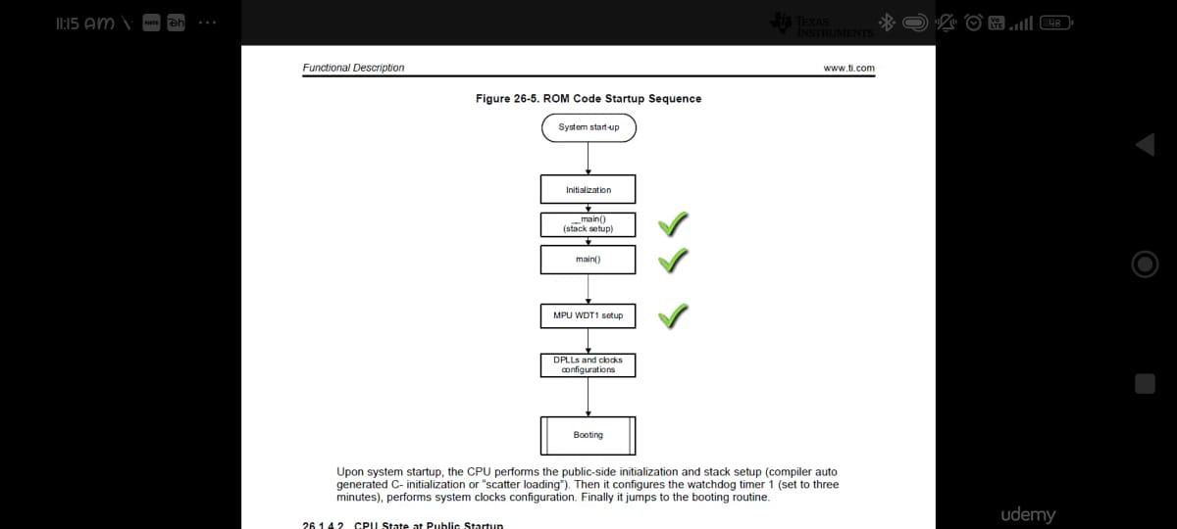
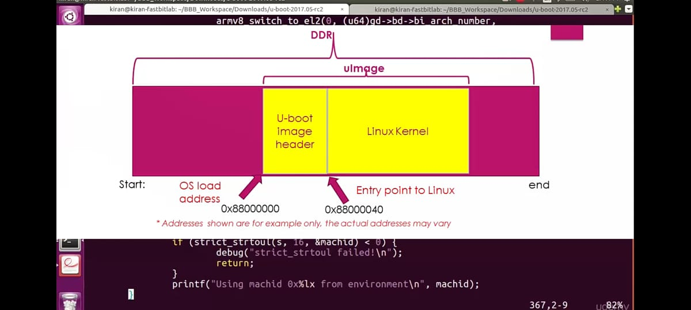

Slide 49
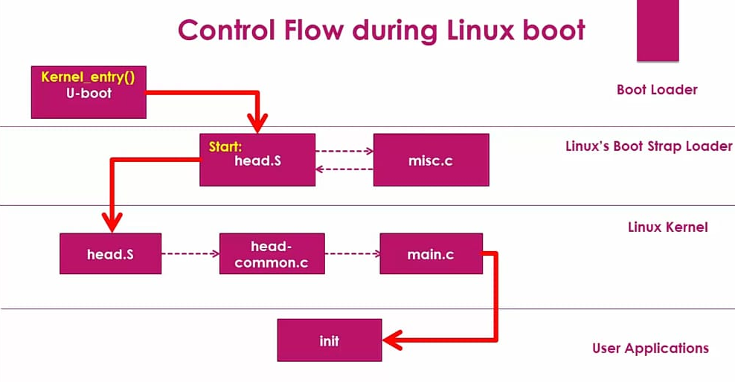

Slide 50
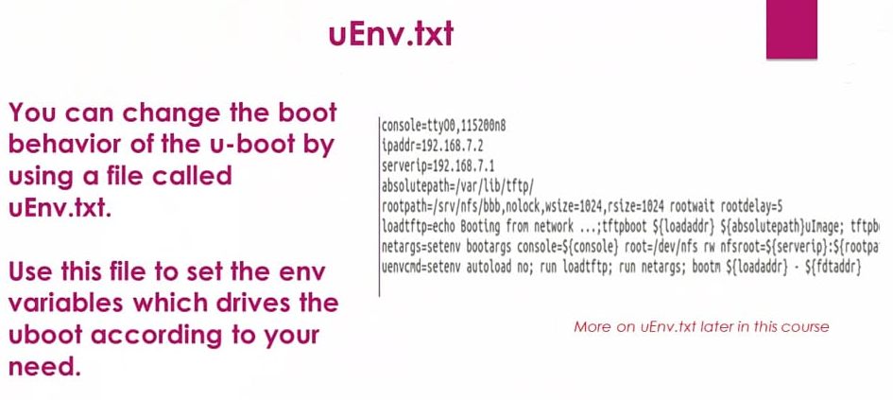
Contd…
U boot contains all board specific information .It can access root files related to some basic booting files. Which can perform some commands to find the root file system(environmental variables)

Slide 51
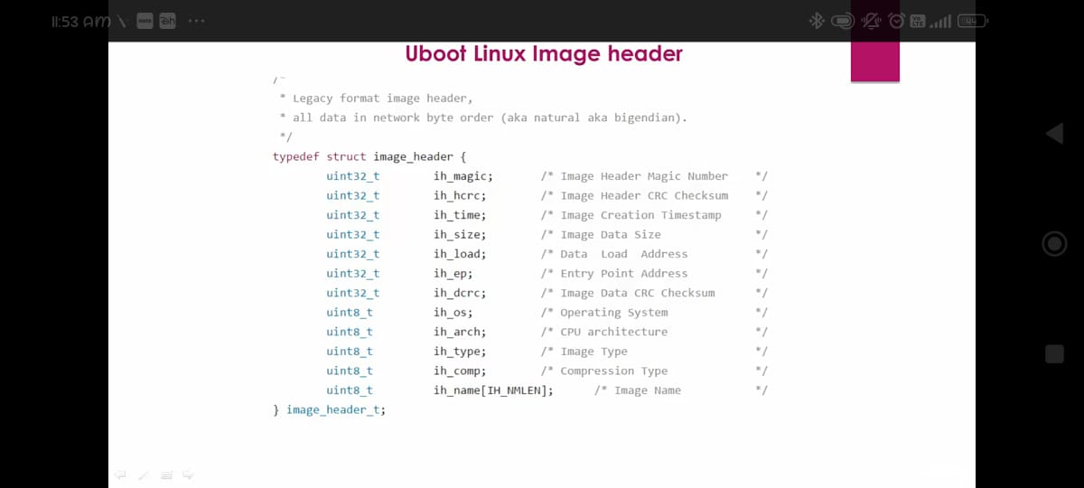
The size of this structure is of 64 bytes.

Slide 52
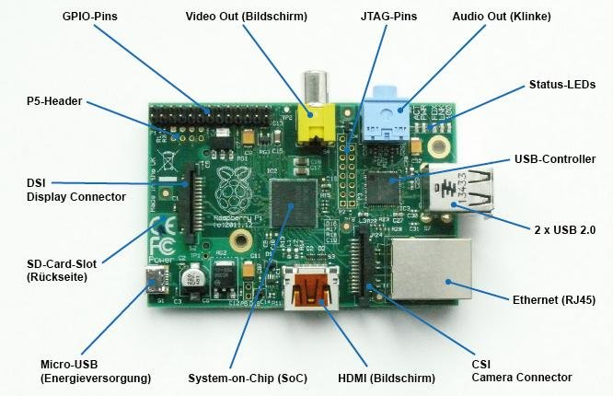
RASPBERRY PI BOOTING PROCESS
The raspberry pi booting process can be done through the external connected SD card which acts as a ROM .In this card able to contain raspberry pi os which is loaded from the raspberry pi imager or can be built by the buildroot .

Slide 53
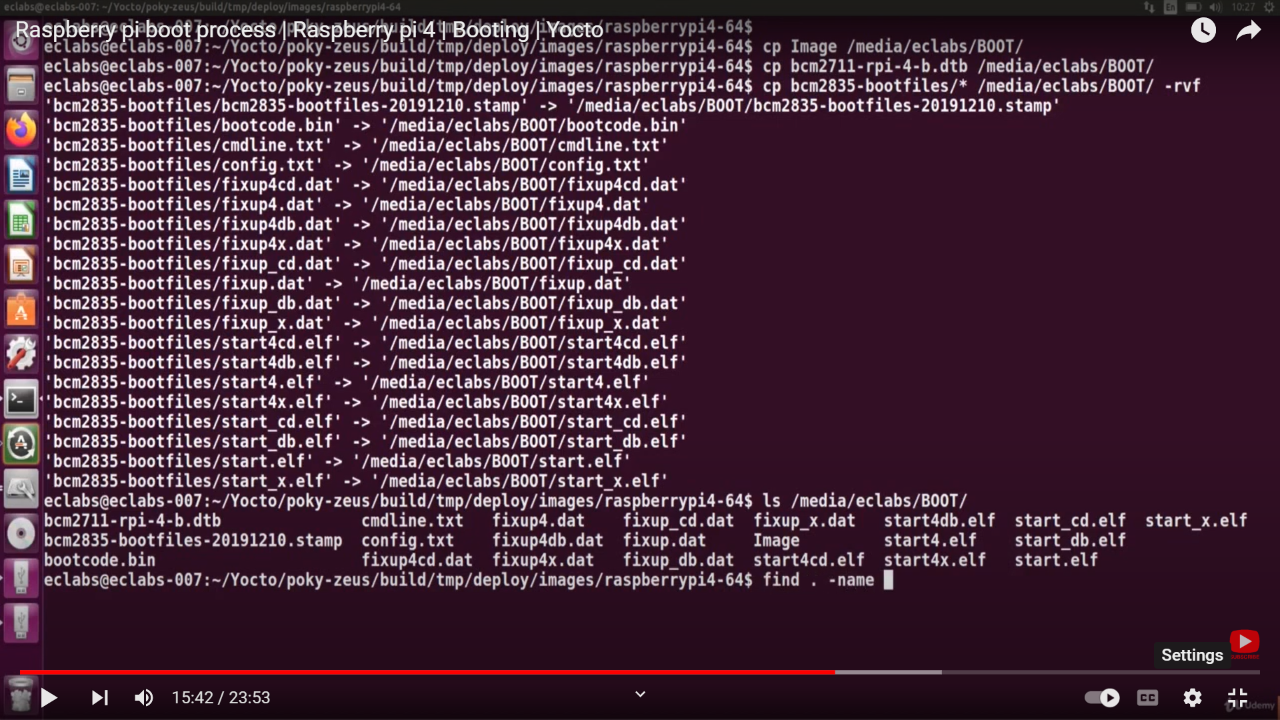
Contd…
This raspberry pi os have some files related to start the soc .Initially required os is not loaded which loads after the bootloader runs. the booting can be given by vendor
Without bootloader we cann’t find the kernel image and root file system in soc.
We able to see the booting process which is done in few second.

Slide 54
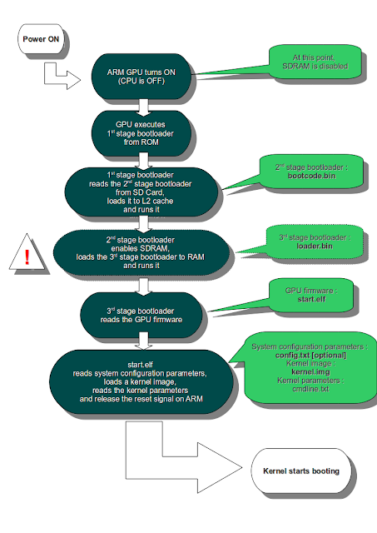

Slide 55
Friendly arm:
Power on
Boot loader
Kernel
OS

Slide 56
What is device tree…?
The "Open Firmware Device Tree", or simply Device Tree (DT), is a data exchange format used for exchanging hardware description data with the software or OS.
More specifically, it is a description of hardware that is readable by an operating system so that the operating system doesn't need to hard code details of the machine.
In short, it is a new and recommended way to describe non-discoverable devices(platform devices) to the Linux kernel, which was previously hardcoded into kernel source files.
DT provides a language for decoupling the hardware configuration from the device driver and board support files of the Linux kernel (or any other operating system for that matter).
Using it allows device drivers to become data-driven. To make setup decisions based on data passed into the kernel instead of on per- machine hardcoded selections.
Ideally, a data-driven platform setup should result in less code duplication and make it easier to support a wide range of hardware with a single kernel image.

Slide 57
Adding Platform devices information to the kernel
During compilation of kernel
Static method
Hardware details are part of kernel files (board file , drivers)
Deprecated and not recommended
Loading dynamically
As a kernel module
Not recommended
During kernel boot
Device tree blob
Latest and recommended

Slide 58
Board file approach
This method was used before the kernel version 3.7 to add hardware configuration details to the kernel.
Details about the onboard peripherals
Pin configuration details
You have to recompile the kernel if any device property changes
All information about hardware configuration is hardcoded in the kernel source files and board files.

Slide 59
Why DT is used ?
Linux uses DT for
Platform identification
Device population:
The kernel parses the device tree data and generates the required software data structure, which will be used by the kernel code.
Ideally, the device tree is independent of any os; when you change the OS, you can still use the same device tree file to describe the hardware to the new OS. That is, the device tree makes “adding of device information “ independent of OS

Slide 60
Writing device tree
The device tree supports a hierarchical way of writing hardware description at the soc level, common board level, and board-specific level. Most of the time, writing a new device tree is not difficult, and you can reuse most of the common hardware information from the device tree file of the reference board.
For example, when you design a new board, which is slightly different from another reference board, then you can reuse the device tree file of the reference board and only add that information which is new in your custom board.

Slide 61
Wifi
3G/4G
modem
keypad
LCD+tsc
Connectors
USB
HOST
Ethernet
JTAG
LED0
LED1
SOC
LED2
DDR3
USER BTN
DC
power
Connectors
Ext
memory
SD
connector
AV
CAN
TXRX
An Embedded Board

Slide 62
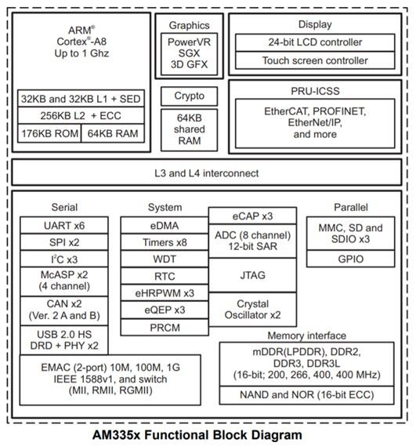
Wifi
3G/4G
modem
keypad
Connectors
Ethernet
JTAG
SOC
DDR3
DC
power
Connectors
Ext
memory
SD
connector
AV
An Embedded Board

Slide 63
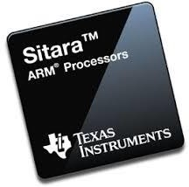
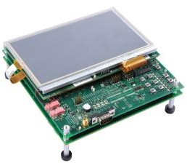
Modular approach to manage DT files
AM335x
(Device tree file 1)
SOC specific device tree file
(This DT file is used as an include file and can be used with another board which is based on same SOC )
Includes
AM335x Evaluation Module (Device tree file 2)
Board specific device tree file

Slide 64
Modular approach to manage DT files
AM335x
dtsi
Beagle bone common
dtsi
Beaglebone black
Beaglebone green
common dtsi
common
dtsi
Beaglebone black
dts
Beaglebone black
Beaglebone Green
dts
Beaglebone green
wireless
dts
wireless
dts

Slide 65
Overview of device tree structure
Device tree is a collection of device nodes.
A ‘device node’ or simply called ‘a node’ represents a device. Nodes are organized in some systematic way inside the device tree file.
They also have parent and child relationship, and every device tree must have one root node.
A node explains itself, that is, reveals its data and resources using its “properties.”

Slide 66
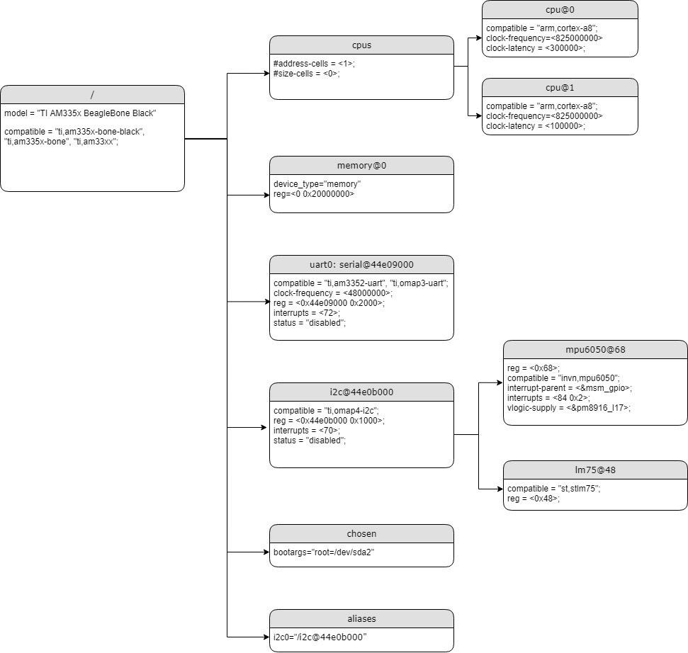

Slide 67
Root node
The device tree has a single root node of which all other device nodes are descendants. The full path to the root node is /.
All device trees shall have a root node, and the following nodes shall be present at the root of all device trees:
One /CPUs node.
At least one /memory node.

Slide 68
Parent and child nodes
CPU
I2c controllers of the SOC
I2C bus
I2c addr = 0x24
I2C-0
TPS65217C
Power Management IC (PMIC)
I2C-1
AM33xx SOC
eeprom
I2c addr = 0x50
32KB EEPROM is provided on I2C0 that holds the board information
Beagle Bone Black board

Slide 69
/ {
Parent
i2c0: i2c@44e0b000 {
tps {
};
eeprom {
};
I2c addr = 0x24
I2C-0
Power Management IC (PMIC)
Child-1
TPS65217C
Child-2
eeprom
I2c addr = 0x50
};
32KB EEPROM is provided on I2C0 that holds the board information

Slide 70
Different types of properties
Standard property
Custom property (non-standard )
Standard properties are those which is explained by the specification and the device-driver binding documentation
Custom properties are specific to a particular vendor or organization which is not documented by the specification.
That is why, when you use custom property, always begin with your organization name.

Slide 71
Property : compatible
compatible = <string-list>
property name(Standard )
Value type
e.g:
compatible = “string1” , “string2” , “string3”;
Compatible property of a device node is used by the Linux kernel to match and load an appropriate driver to handle that device node (driver selection)
The string list provided by the compatible property is matched against the string list supported by the driver. If the kernel finds any match, the driver will be loaded, and probe function is invoked

Slide 72
Root compatible property of BBB
/ {
model = "TI AM335x BeagleBone Black";
compatible = "ti,am335x-bone-black", "ti,am335x-bone", "ti,am33xx";
};
Sorted string list from most compatible to least.
Root compatible property is used for machine identification

Slide 73
Device tree bindings
How do you know which property name and value pair should be used to describe a node in the device tree?
Device tree binding document. The driver writer must document these details
The properties that are necessary to describe a device in the device tree depends on the requirements of the Linux driver for that device
When all the required properties are provided, the driver of charge can detect the device from the device tree and configure it.

Slide 74
Note:
Compatible strings and properties are first defined by the client program (OS , drivers ) then shared with DT writer
DT implementation
Driver implementation
Driver decides compatible strings and documents in device tree binding document
DT writer refers to the binding document and initializes relevant values for the compatible property

Slide 75
Linux conventions to write device tree
hex constants are lower case
use "0x" instead of "0X"
use a..f instead of A..F, eg 0xf instead of 0xF
node names
should begin with a character in the range 'a' to 'z', 'A' to 'Z'
unit-address does not have a leading "0x" (the number is assumed to be hexadecimal)
unit-address does not have leading zeros
use dash "-" instead of underscore "_"
label names
should begin with a character in the range 'a' to 'z', 'A' to 'Z'
should be lowercase
use underscore "_" instead of dash "-"
property names
should be lower case
should begin with a character in the range 'a' to 'z'
use dash "-" instead of underscore "_"

Slide 76
examples
org,size = <512> ; //this is a non standard property and represents integer data ;
org,device-serial-num = “PCDEV1ABC123” ; //this is a non standard property and represents string data
org,perm = <0x11> ; //this is a non standard property and represents integer data

Slide 77
CONFIG_OF configuration item
In Linux, CONFIG_OF configuration item decides Device Tree and Open Firmware support
If CONFIG_OF is not enabled, Linux doesn’t support hardware enumeration via device tree.
All device tree processing functions which begin with of_* will be excluded from the kernel build
For latest kernel this configuration item is enabled by default
Device tree overlays
DT overlays are device tree patches(dtbo) which are used to patch or modify the existing main device tree blob(dtb)

Slide 78
Two ways you can include the device nodes for the cape device in the main dtb
Edit the main dtb itself.
Overlay( a Patch which overlays the main dtb)
Uses of overlays
To support and manage hardware configuration (properties, nodes, pin configurations ) of various capes of the board
To alter the properties of already existing device nodes of the main dtb
Overlays approach maintains modularity and makes capes management easier

Slide 79
REFERences
https://www.oreilly.com/library/view/linux-in-a/0596004826/ch04s03.html
https://tldp.org/LDP/intro-linux/html/sect_04_02.html
https://kernel.org/
www.raspberrypi.com
www.ti.com
www.beagleboard.org
www.techarkit.com
https://www.design-reuse.com/exit/?urlid=1500
ARM335X and AMIC110 sitara processors technical reference manual.
https://www.devicetree.org/
Kernel source code:documents/device tree.
Kernel source code:documents/arm/booting.

Slide 80
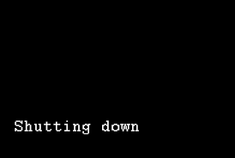
Thank you

